Slide 1
OO DESIGN
A Software design is a description of the structure of the software to be implemented, the data which is part of the system, the interfaces between system components and sometimes the algorithms used.

Slide 2
Object-oriented Design
Designing systems using self-contained objects and object classes

Slide 3
Objects and Classes
Objects are entities in a software system which represent instances of real-world and system entities. E.g. An object is any person, place, thing, concept, event, screen, or report applicable to your system.
Objects both know things (they have attributes) and they do things (they have methods).
A class is a representation of an object, it is a template from which objects are created. Classes form the main building blocks of an object-oriented application.
e.g.Thousands of students attend the university, you would only model one class, called Student, which would represent the entire collection of students.)

Slide 4
Attributes
Real world things have characteristics
  How is this object described in general?
  What parts of general description are applicable to this domain.
  What is the minimal description needed for this application?

Slide 5
Methods
A set of operations that an object performs when another object requests a service.
A set of actions that an object should exhibit
Specifies a behaviour of an object

Slide 6
Object communication
Conceptually, objects communicate by
message passing.
e.g.
// Call a method associated with a buffer
// object that returns the next value
// in the buffer
v = circularBuffer.Get () ;
// Call the method associated with a
// thermostat object that sets the
// temperature to be maintained
thermostat.setTemp (20) ;

Slide 7
Design models
Static models describe the static structure of the system in terms of object classes and relationships
Dynamic models describe the dynamic interactions between objects.

Slide 8
Object identification
Identifying objects (or object classes) is the most difficult part of object oriented design
There is no 'magic formula' for object identification. It relies on the skill, experience and domain knowledge of system designers
Object identification is an iterative process. You are unlikely to get it right first time

Slide 9
Approaches to identification
Use a grammatical approach based on a natural language description of the system
Base the identification on tangible things in the application domain
Use a behavioural approach and identify objects based on what participates in what behaviour
Use a scenario-based analysis. The objects, attributes and methods in each scenario are identified

Slide 10
Identifying Classes
There are 3 types of classes
  Actor classes e.g. students, lecturers
  Business classes –place, things, concepts and events that describe what the business is about e.g. room, course, seminars
  UI classes e.g. enroll in seminar, transcript
  (look for nouns in the requirements document)

Slide 11
Approach for identifying responsibilities
Identify attributes
  Look at all adjectives and possessive phrases in the requirements document e.g. dogs collar, girls name
  Ask the following questions:
    How is this object described in general?
    What parts of the general description are applicable to this problem domain?
Specify attributes
  Make each attribute an “atomic concept”.
  Eliminate attributes that are calculable or derivable from the basic attributes.

Slide 12
Approach for identifying responsibilities contd.
Identify services
  Look at verbs in the requirements document. Remember that the verb usually defines the services of the objects of the sentence.
  Look at the user scenarios, which usually identify a lot if services.
  Look at each feature, which usually requires services from many objects.
Specify services
  Give a name to the service that is externally (relative to itself) focused.

Slide 13
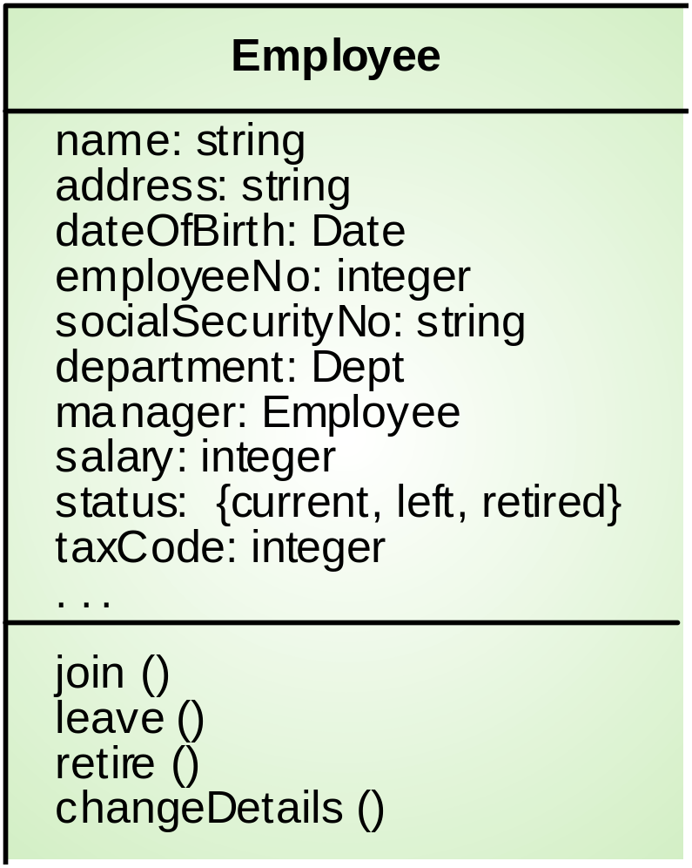
Employee object class (UML)

Slide 14
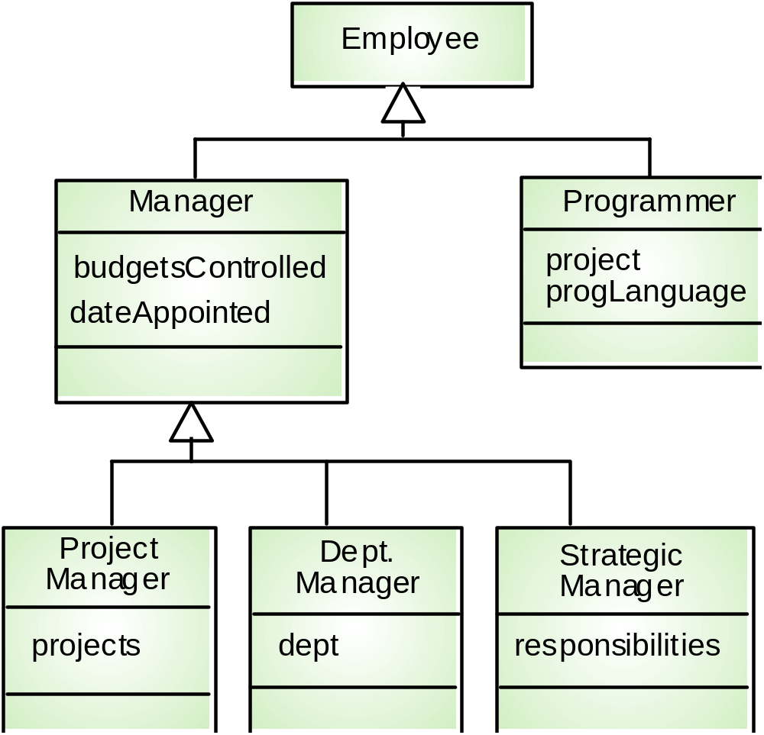
A generalisation hierarchy

Slide 15
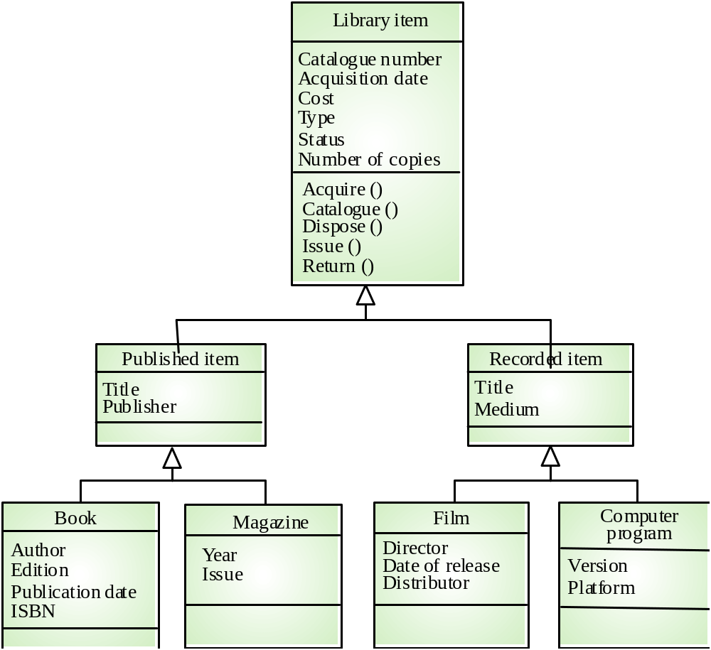
Library class hierarchy

Slide 16
Advantages of inheritance
It is an abstraction mechanism which may be used to classify entities
Inheritance models “is a” relationships
It is a reuse mechanism that takes advantage of the similarities that exist between different classes at both the design and the programming level

Slide 17
Associations
Objects have relationships, associations to other objects.
  They show interactions e.g students TAKE courses, lecturers TEACH courses
Relationships need to be described e.g. How many courses can a student take?

Slide 18
UML - Associations
Students
Seminar
StudentID getId()
getseminarstaken()
1..*
1..*
Name
Seminar Number
Associations denote relationships between classes.
The multiplicity of an association end denotes how many objects the source object can legitimately reference.

Slide 19
More UML: Multiplicity
Patron
0..1 checks out 0..*
Resource
Multiplicity or cardinality is represented above by the 0..1 and 0..*
The above diagram indicates that a resource is checked out by 0 or 1 patrons and that each patron may check out 0 to many resources

Slide 20
1-to-1 and 1-to-Many Associations
Has-capital
Country
1
1
City
name:String
name:String
1-to-1 association
Polygon
1
*
Point
x:Integer
y:Integer
draw()
1-to-many association

Slide 21
Aggregation
An aggregation is a special case of association denoting a “consists of” hierarchy.
Sometimes objects are made of other objects
It represents “a part of” relationship.
In UML it is denoted by a hollow diamond
Program
Courses
0..*
1..*

Slide 22
Patron
Overdue
form letter
Resource
The hollow diamond indicates that the Overdue form letter class consists of Patron and Resource objects
The hollow diamond indicate that the Patron and Resource classes exist in their own right

Slide 23
Composition
A solid diamond denote composition, a strong form of aggregation where components cannot exist without the aggregate.
A good rule - when both classes represent physical items and aggregate makes sense.
Exhaust System
1
0..2
Muffler
Tailpipe

Slide 24
Courses
Tutorials
1..*
TicketMachine
3
ZoneButton

Slide 25
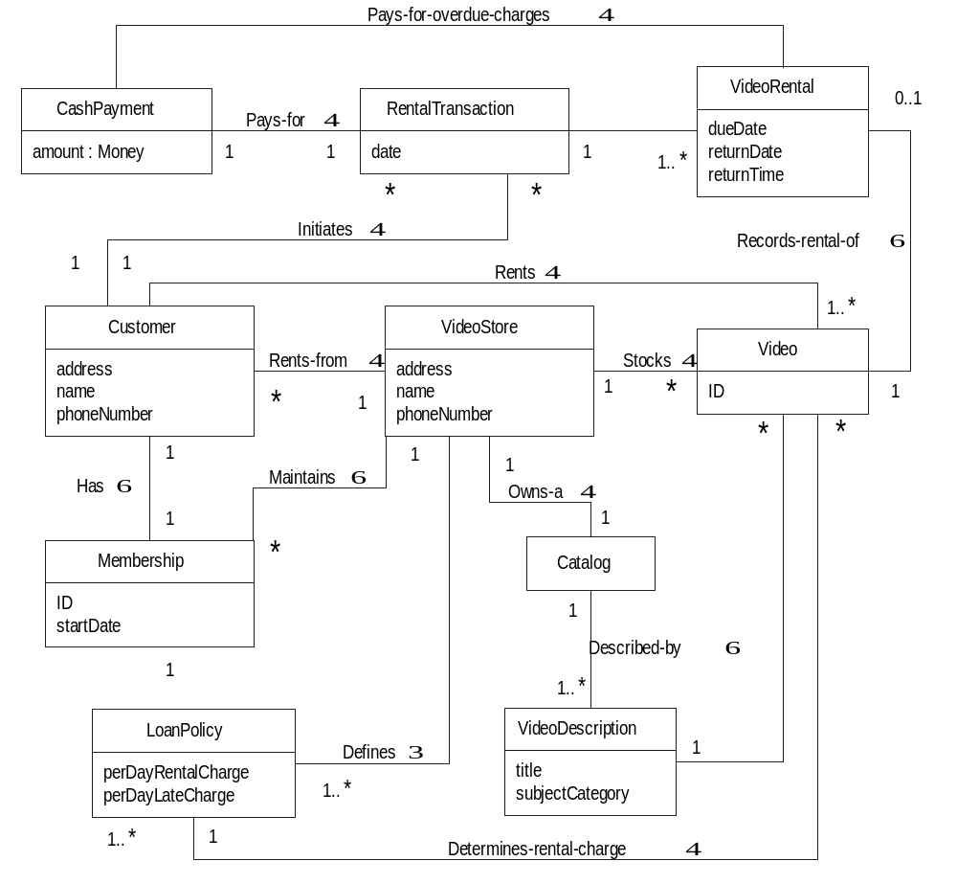

Slide 26
Verification of the Class Design
All system requirements developed during analysis must be addressed during design
  All design documents must cross reference requirements from the requirements specification
All required attributes and methods must be used properly
  e.g. data integrity of attributes must be enforced by update methods
The modules comprising the system must work together properly

Slide 27
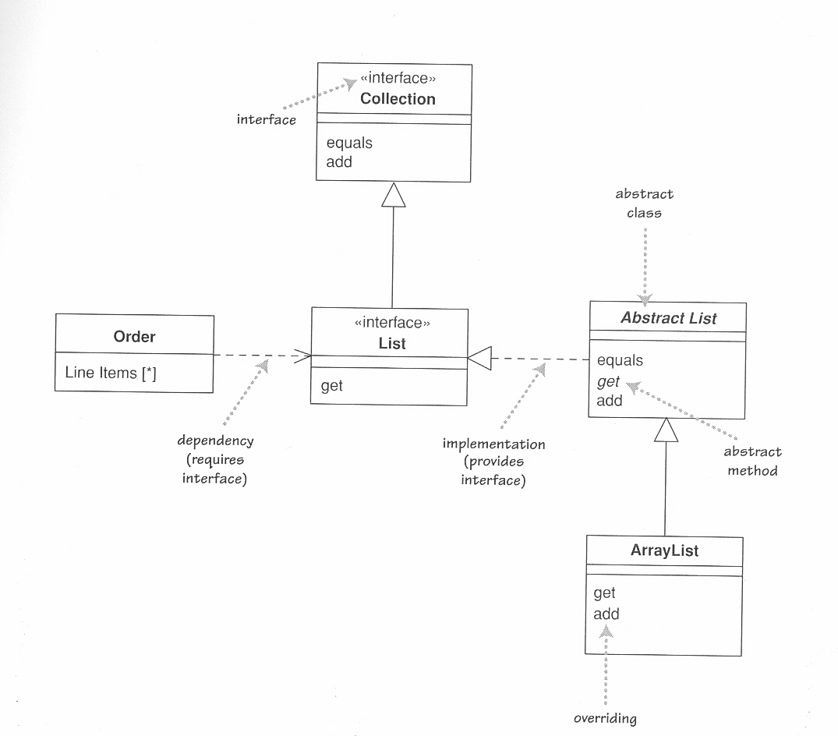
Complex Class diagrams

